Slide 1
ShanghaiTech University
EE 115B: Digital Circuits
Fall 2024
Lecture 4
Hengzhao Yang
October 10, 2024

Slide 2

Boolean Algebra and Logic Simplification
Boolean Algebra
Logic Simplification
  Karnaugh Map
  Quine-McCluskey Method
Prof. Yajun Ha

Slide 3
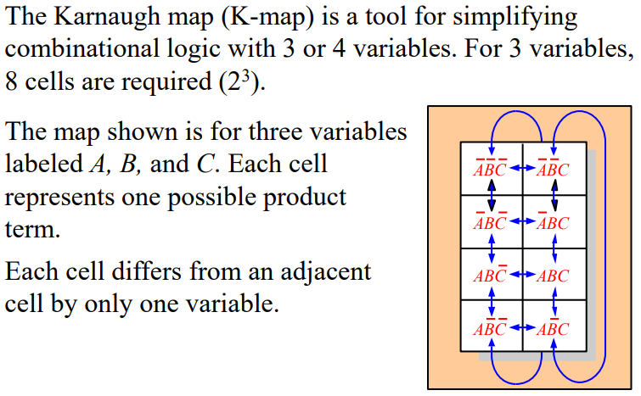
Karnaugh Maps
Prof. Yajun Ha
Notes:
Title

Slide 4
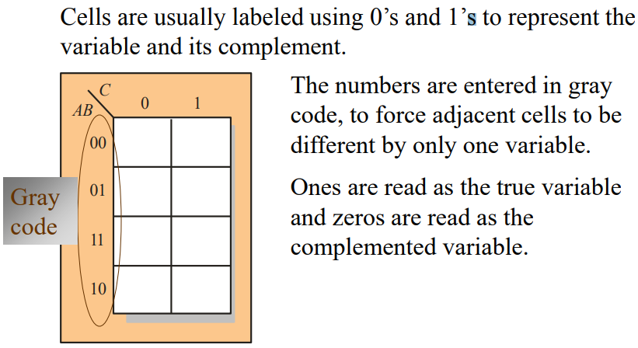
Karnaugh Maps
Prof. Yajun Ha
Notes:
Title

Slide 5
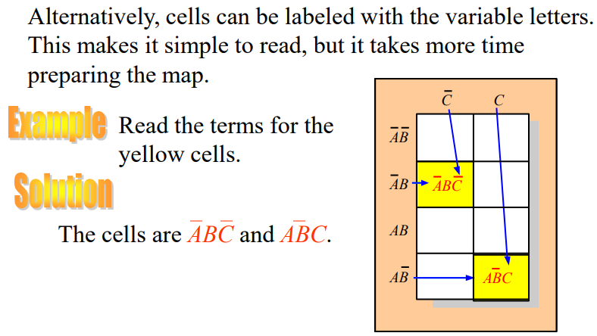
Karnaugh Maps
Prof. Yajun Ha
Notes:
Title

Slide 6
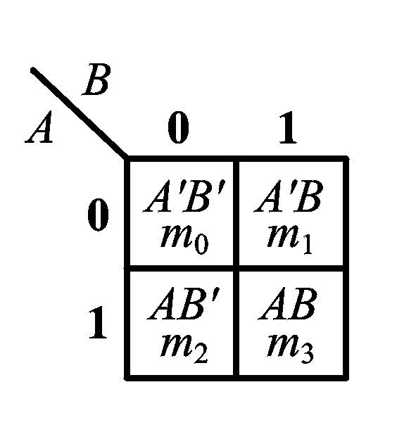
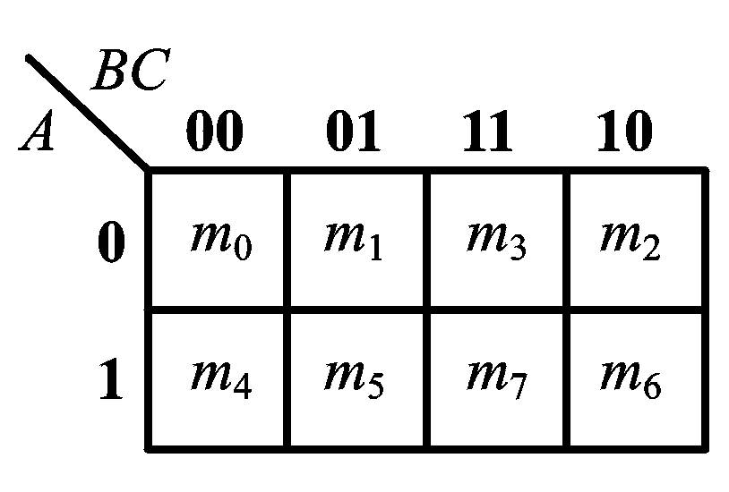
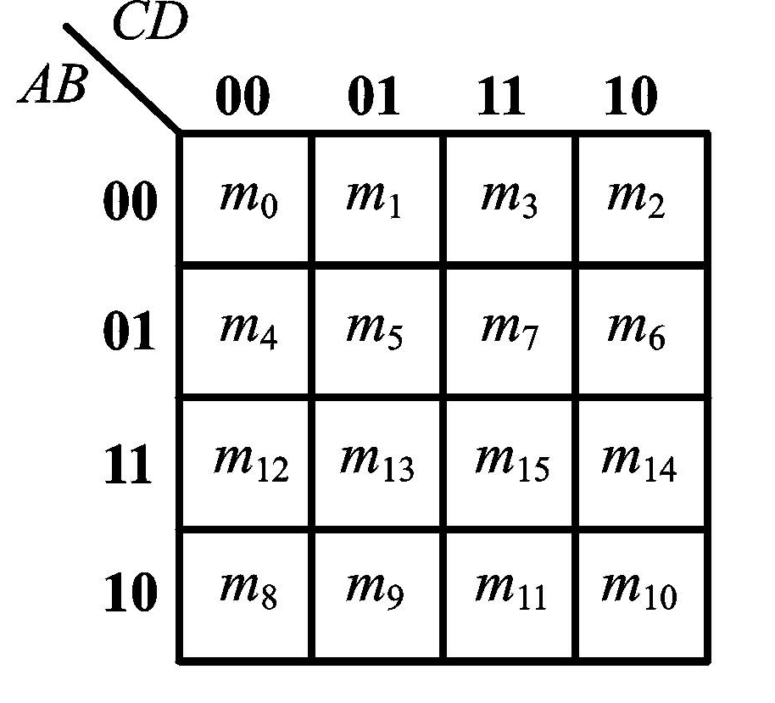
表示最小项的卡诺图
二变量卡诺图 三变量的卡诺图
4变量的卡诺图

Slide 7
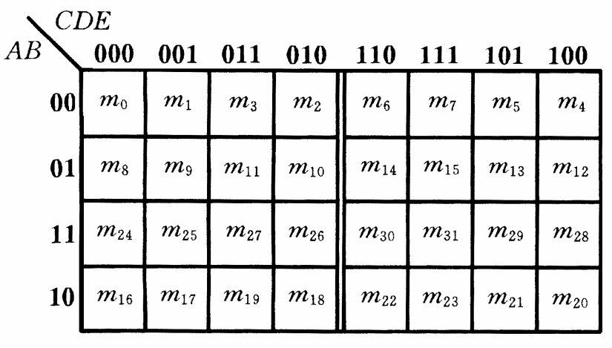
五变量的卡诺图
Notes:
已经不能直观地用平面上的几何相邻表示逻辑相邻，以中轴左右对称的最小项也是相邻的
因此，超过4个变量后，卡诺图失去直观性的优点，一般不用这种方法表示，化简函数

Slide 8
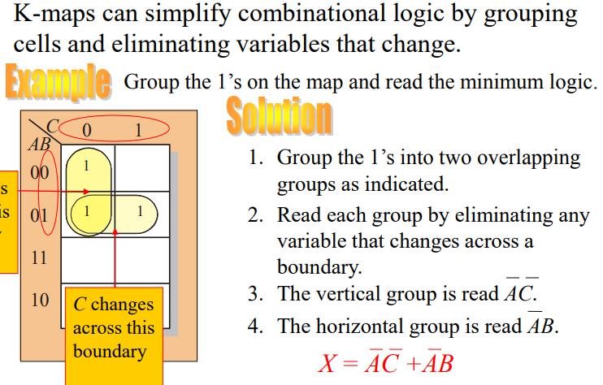
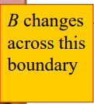
Karnaugh Maps
Prof. Yajun Ha
Notes:
Title

Slide 9
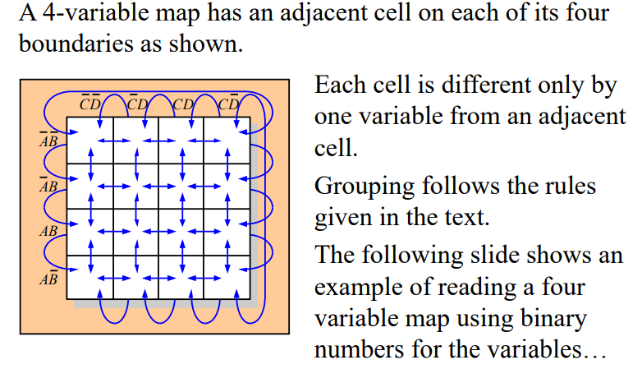
Karnaugh Maps
Prof. Yajun Ha
Notes:
Title

Slide 10
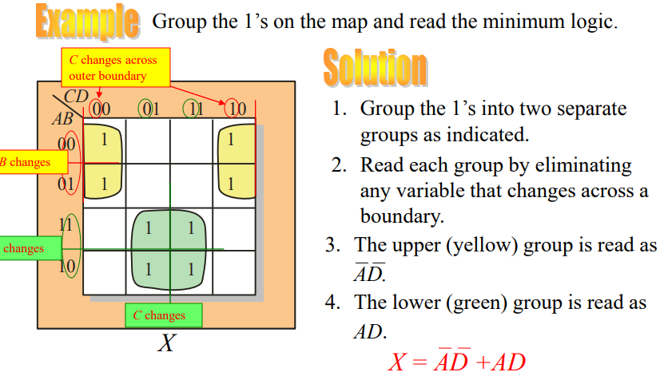


Karnaugh Maps
Prof. Yajun Ha
Notes:
Title

Slide 11
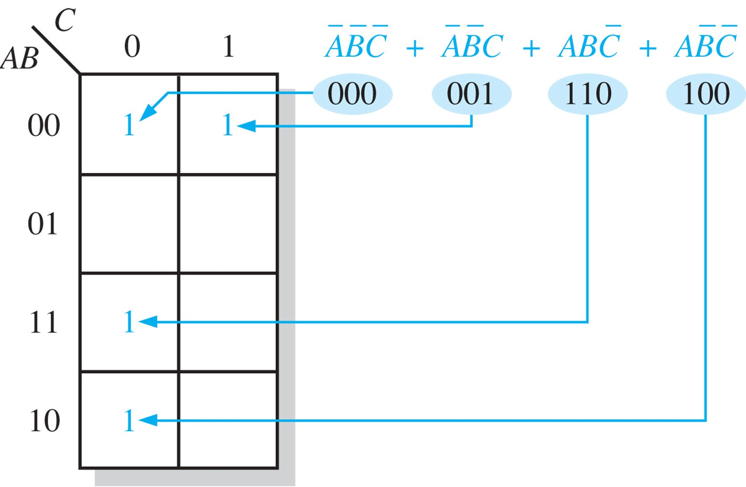
Mapping a standard SOP expression
_________________________________________________
Place a “1” for each minterm.

Slide 12
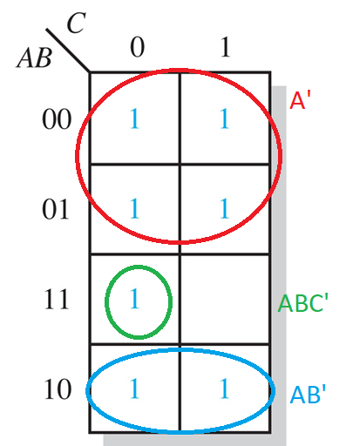

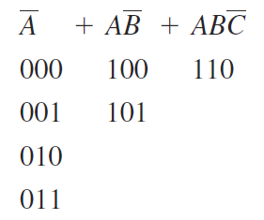
Mapping a nonstandard SOP expression
_________________________________________________
Expand product terms to minterms and place a “1” for each minterm.
Example: Map
Solution:

Slide 13
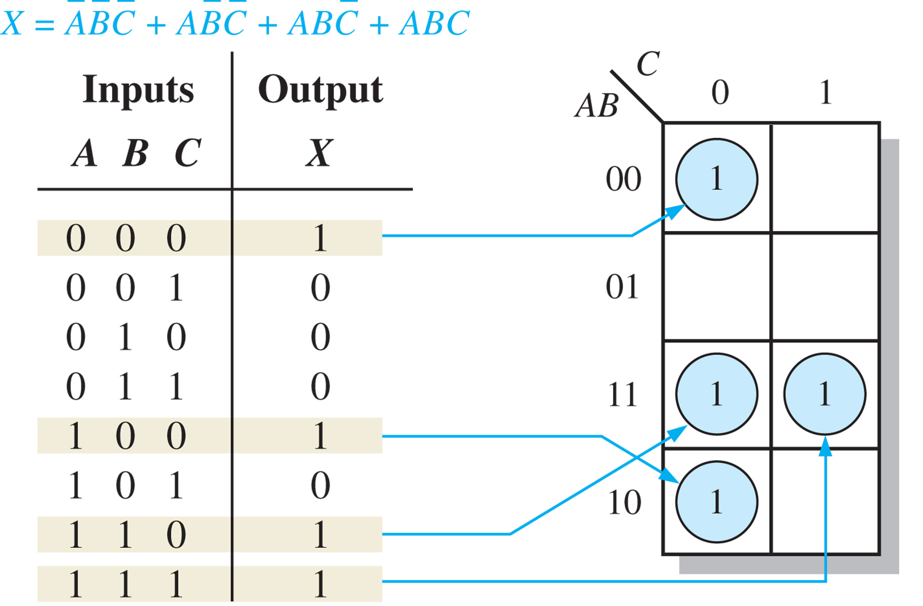
Mapping directly from a truth table
_________________________________________________

Slide 14
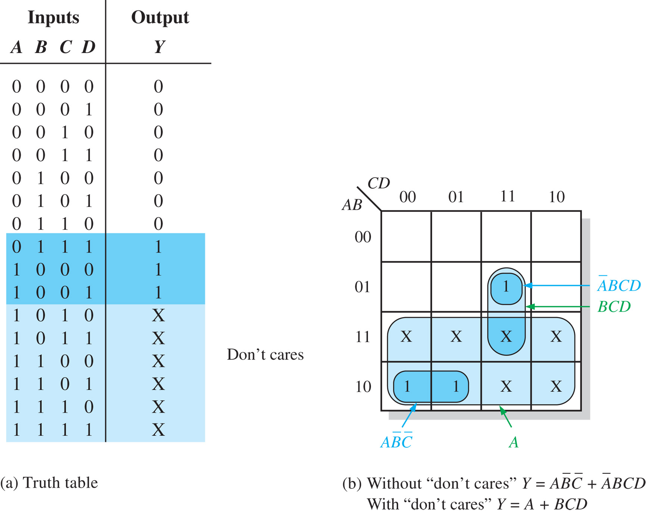
“Don’t care” conditions
_________________________________________________
“Don’t care” term can be “1” or “0”. Denoted by “X”.
Example: Output is “1” when input BCD code is 7, 8, or 9.
Y=∑m(7,8,9)+
D(10,11,12,13,14,15)

Slide 15
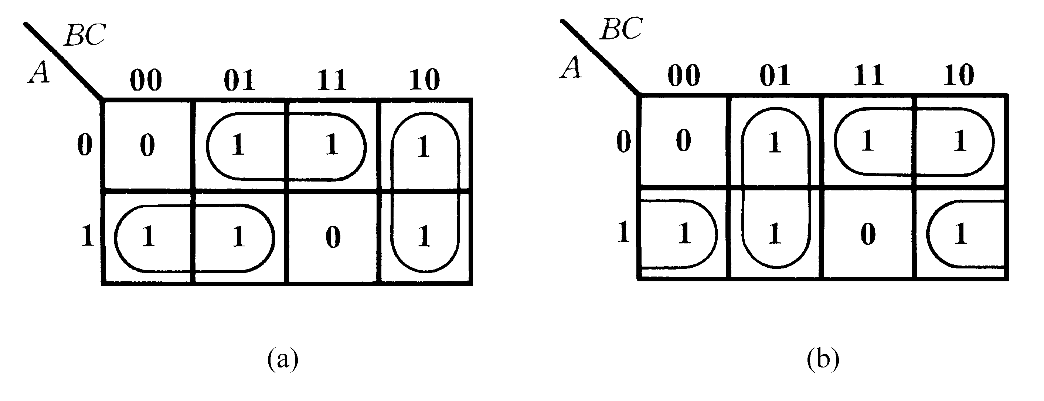


例：Determine the minimum SOP expression.
化 简 结 果 不 唯 一

Slide 16

例：Determine the minimum SOP expression.
Work on 1’s
Work on 0’s
  (a) Take 0’s as 1’s (i.e., invert truth table or K-map)
  (b) Write SOP for these 1’s to get Y’
  (c) Invert Y’ to get Y
Y’=A’D
Y=(Y’)’=A+D’
CD
 | 00 | 01 | 11 | 10
00 | 1 | 0 | 0 | 1
01 | 1 | 0 | 0 | 1
11 | 1 | 1 | 1 | 1
10 | 1 | 1 | 1 | 1
AB

Slide 17
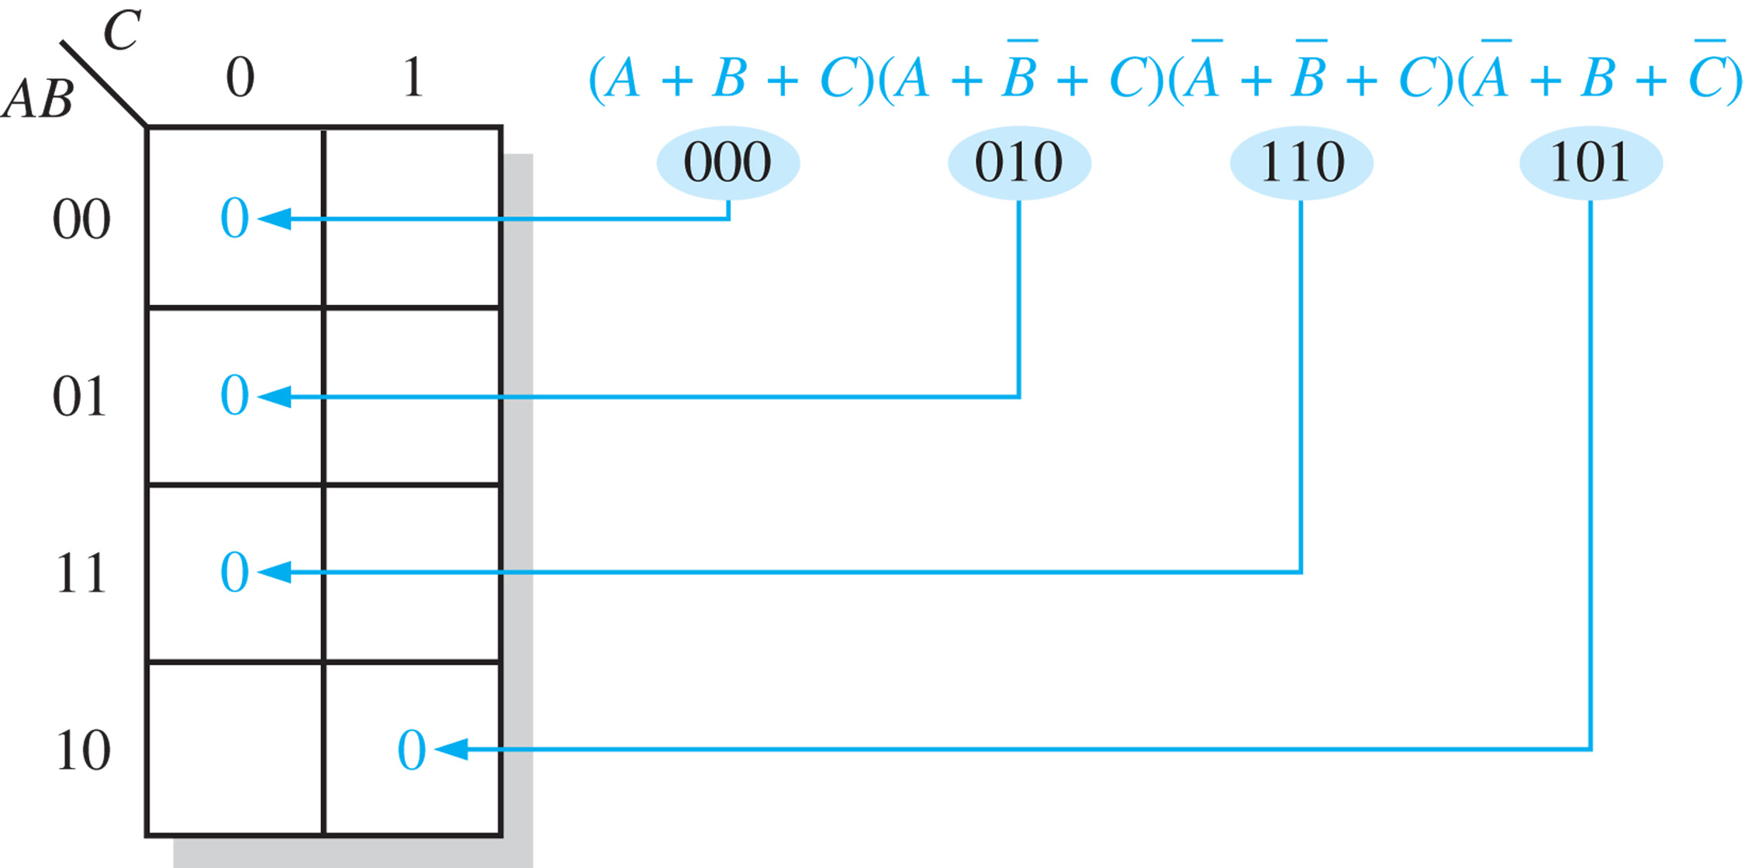
Mapping a standard POS expression
_________________________________________________
Place a “0” for each maxterm.

Slide 18
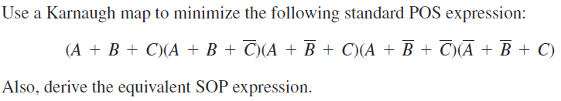
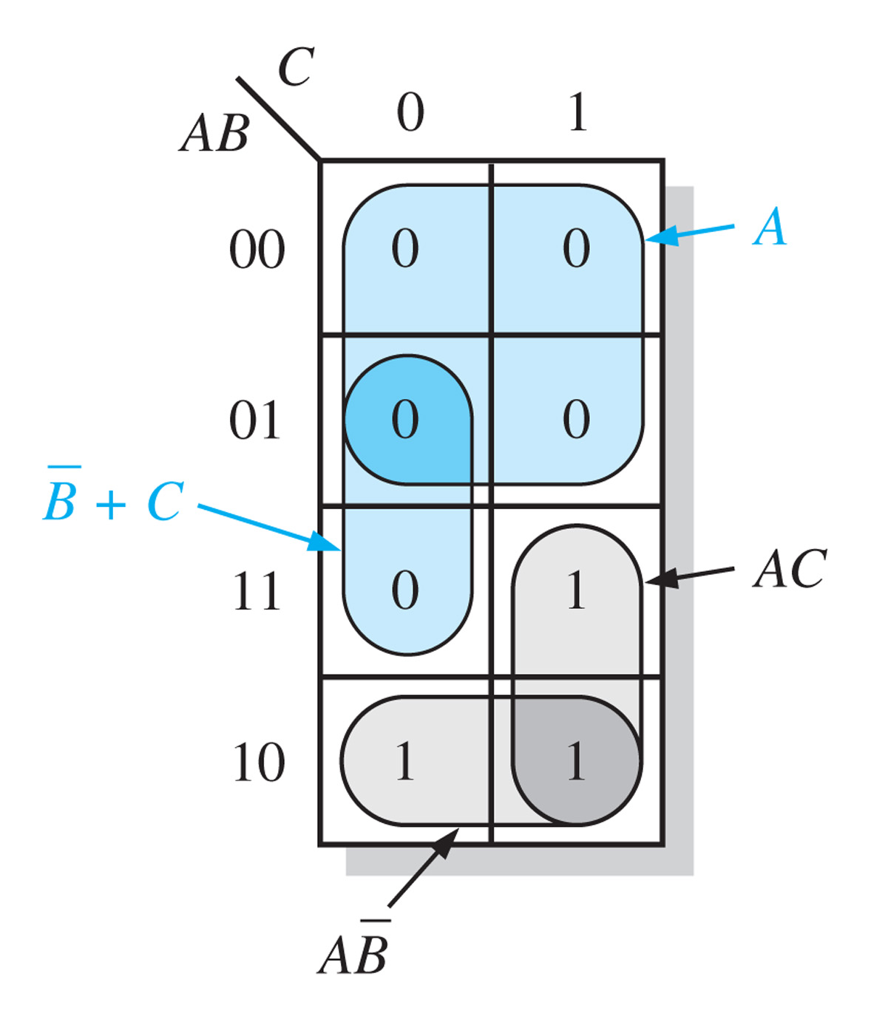


Karnaugh map simplification of POS expressions
_________________________________________________
Group 0’s to determine the minimum POS expression.
Solution: (1) Minimum POS: group 0’s
(2) Minimum SOP: group 1’s

